Slide 1
Facial Recognition Drawer
Unlock System
ITAI 2277
Project Proposal By: Elijah Ghaya, Ezra Bakatubia, Jesus Chavez-espino, Liqa Hasan Syed Mohammed Zaidi

Slide 2
Table Of Contents
Project Objective
Feasibility Assessment
Background Research
System Architecture
Wireless Protocol (ESP-NOW)
Hardware Cost Breakdown
Logic Flow
Face ID Enrollment
Initial Problem Solving
Conclusion & Future Scope

Slide 3
Project Objective
Modernizing Security: The project replaces traditional key-based locks with a seamless facial recognition system to secure sensitive documents and valuables.
Eliminating Physical Keys: By using biometrics, the system removes the vulnerability of lost or stolen physical keys.
Industry Alignment: The design responds to a growing market trend toward contactless, IoT-integrated security in residential and commercial sectors.
Efficiency at the Edge: Utilizing the ESP32-S3 allows for "instant-on" facial recognition locally, meaning it doesn't rely on a constant internet connection to function.

Slide 4
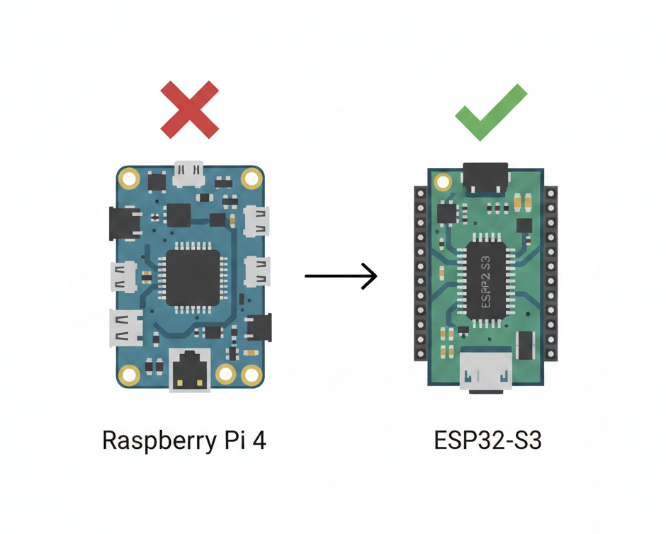
Technical Viability: ESP32-S3 microcontrollers perform on-device facial detection at "the edge" for instant response.
Performance Comparison: Unlike the Raspberry Pi, the ESP32-S3 is optimized for battery-operated furniture due to its low power consumption.
Mechanical Integration: Standard 12V solenoid locks offer a secure, "fail-secure" barrier easily fitted to wooden frames.
Feasibility Assessment

Slide 5
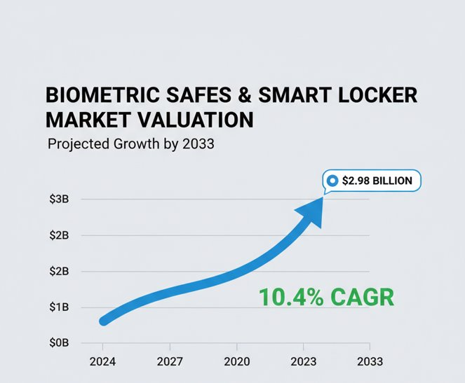
Background Research
Industry Market Trends:
Market Valuation: The biometric safes and smart locker industry is projected to reach approximately $2.98 billion by 2033, reflecting a steady 10.4% Compound Annual Growth Rate (CAGR).
Security Evolution: There is a global shift away from traditional mechanical keys toward contactless and IoT-integrated biometric authentication in both residential and high-security commercial sectors.
Edge Computing Adoption: Modern security designs are increasingly moving toward "Edge AI" (processing data locally on the device) to enhance user privacy and ensure the system functions during network outages.

Slide 6
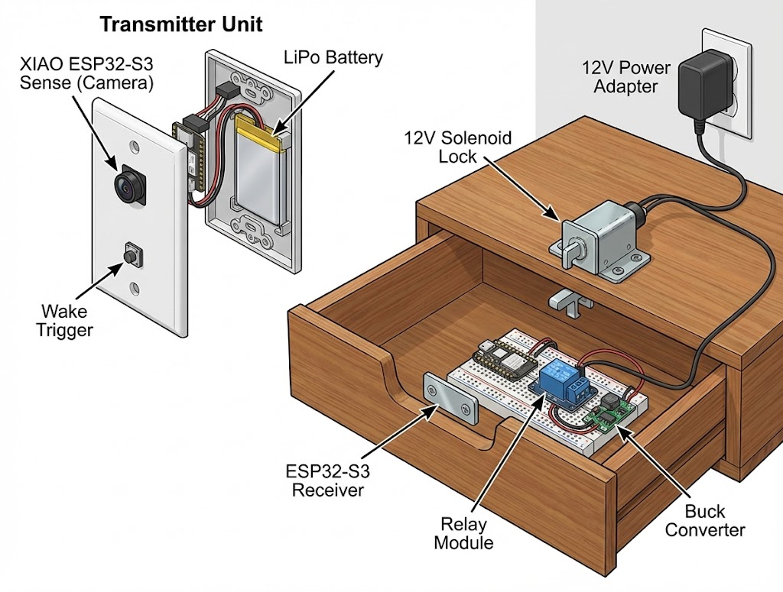
Compute: Dual-Microcontroller Setup: The system operates using two independent ESP32 nodes.
Transmitter (XIAO ESP32-S3 Sense): Primary camera node for biometric capture and processing.
Receiver (ESP32-S3 DevKit): Dedicated node for managing lock actuation and security logic.
Optics: OV2640 camera module integrated within the ESP32-S3 Sense.
Actuation: 12V DC Solenoid Cabinet Lock and a 5V Relay Module.
Power: 12V 2A Power Adapter and a Buck Converter (12V to 5V).
Software & Compute Resources
Software Stack: C++ for real-time edge performance and Python for data processing.
Core Libraries: ESP-WHO (biometrics) for the ESP32-S3 Sense, ESP-NOW (wireless communication), and OpenCV (image processing) for enrolling the face IDs.
Development Platform: Arduino IDE
Data Requirements
Training Set: A small database of "Authorized Face Encodings." This requires high-resolution images of the primary user at various angles and lighting conditions to ensure reliability.
System Architecture

Slide 7
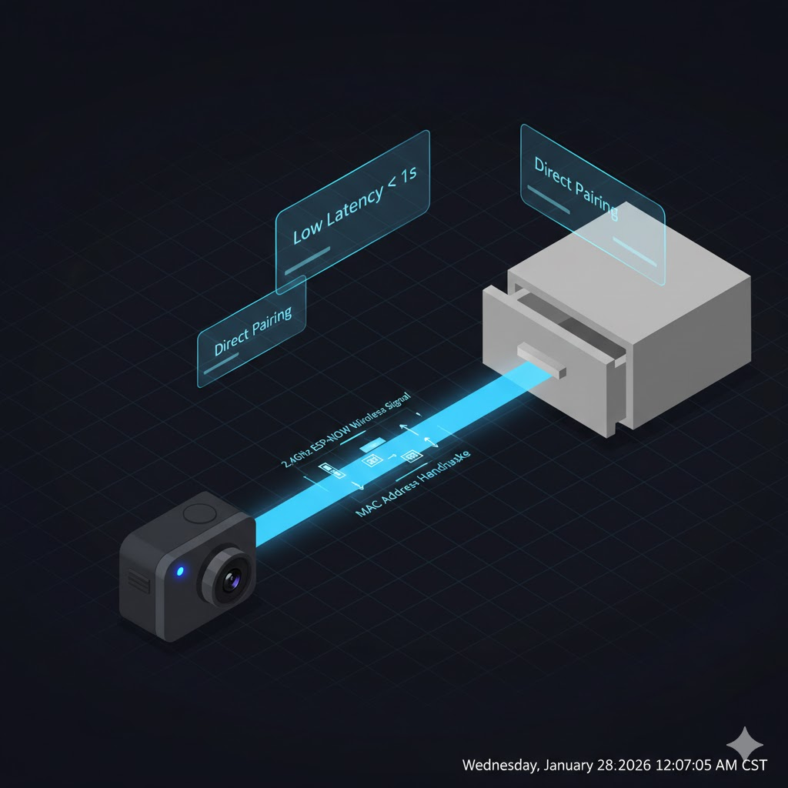
Wireless Protocol: ESP-NOW
Protocol Choice: Utilizes ESP-NOW, a high-speed, 2.4GHz connection protocol.
Low Latency: Eliminates router handshake time, allowing the transmitter to trigger the lock in under a second.
Security: Employs direct MAC-address pairing between the camera unit and the drawer unit.

Slide 8

Hardware Cost Breakdown
Item | Cost
XIAO ESP32-S3 Sense (Transmitter) ESP32-S3-DevKitC-1(Receiver) 12V Solenoid Lock 5V Relay Module Power Supply & Buck Converter 400 Points Solderless Breadboard EEMB 3.7V LiPo Battery 500mAh DAOKI 100Pcs Tact Button Mounting Bracket for the ESP32-S3 Sense Jumper Wires Kit | $23.99 $15.00 $15.49 $6.99 $15.96 $7.99 $8.18 $4.99 $6.98
Total Cost: $100.97

Slide 9
Logic Flow
The system operates through both physical hardware and the backend integrated through a mobile application. Users capture and program their facial data into the app. The app allows the primary administrator to select specific "Authorized Faces" that are then synced to the local device (ESP32-S3 Sense). When the system is triggered from "Deep Sleep" by the click of a button, the camera captures a live frame to detect a human face using a CNN model, which is then converted into a mathematical encoding for verification. If a match is found, the microcontroller sends a signal to the 5V relay. Upon a successful match, the GPIO pin triggers the 5V relay to retract the 12V solenoid for 20 seconds, allowing secure access.
Trigger Phase:
System wakes from Deep Sleep via the click of a button.
Detection Phase:
Camera identifies a face presence using Haar Cascade or CNN.
Recognition Phase:
Captured face is mathematically matched against stored data.
Actuation Phase:
GPIO pin triggers the relay to retract the solenoid lock.

Slide 10
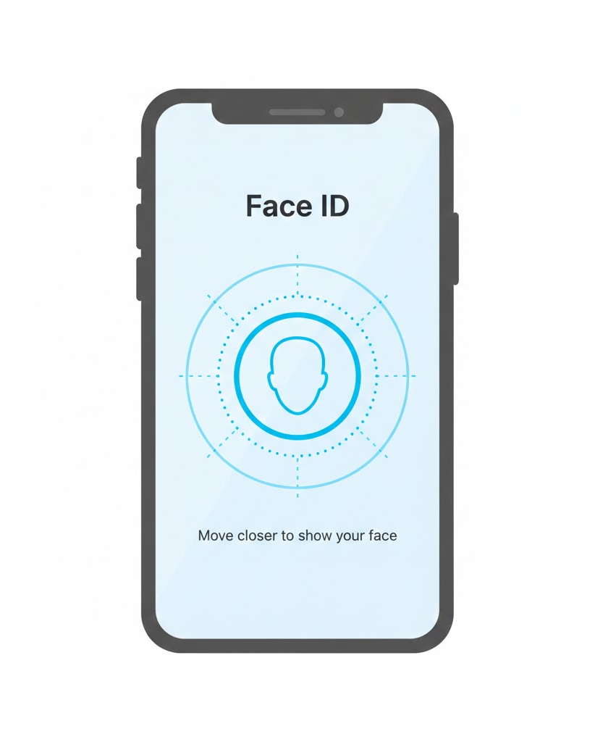
Face ID Enrollment
Mobile Framework: Developed for Android/iOS to handle user registration and profile management.
API/Communication: Uses HTTP or MQTT for real-time communication between the phone and the transmitter for the drawer lock.
Facial Database: Enrolled face templates (feature vectors) are captured via the app and synced to the ESP32’s PSRAM for fast matching.

Slide 11
Initial Problem-Solving Discussion
Lighting Variability: Facial recognition often fails in low light. Solution: We can integrate a small infrared (IR) LED or a standard white LED that flashes during the detection phase.
Power Failures: If the 12V supply is cut, the drawer remains locked. Solution: We can include a hidden physical override or a backup battery circuit.
Latency: Raspberry Pi systems can have slow boot times. Using a microcontroller like the ESP32-S3 ensures the system is ready to scan in under a second.
Falsification: Standard facial recognition can be fooled by a high-resolution photo of the user held up to the camera. Solution: Liveness Detection which could be as simple as blinking once.

Slide 12
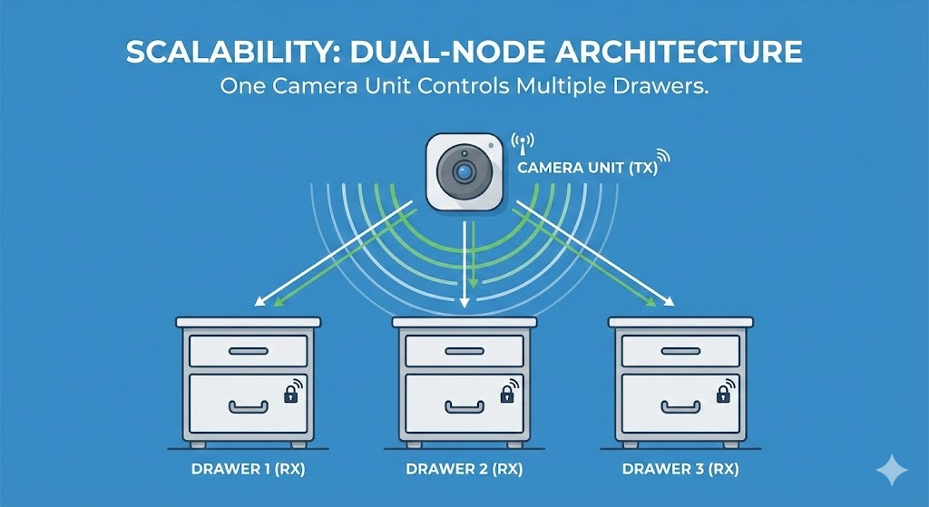
Conclusion & Future Scope
Summary: Developed a wire-free, biometric solution for high-security storage.
Future Scope: Expanding the system to include audit logs via IoT to track every successful and failed entry attempt.
Scalability: The dual-node architecture allows for multiple drawers to be controlled by one camera unit.

Slide 13
Thank you

